Slide 1
CS 435: Algorithms
Heap sort
Emdad Khan

Slide 2
Heaps
A heap can be seen as a complete binary tree:
  What makes a binary tree complete?
  Is the example above complete?
16
14
10
8
7
9
3
2
4
1
Emdad Khan

Slide 3
Heaps
A heap can be seen as a complete binary tree:
  The book calls them “nearly complete” binary trees; can think of unfilled slots as null pointers
16
14
10
8
7
9
3
2
4
1
1
1
1
1
1
Emdad Khan

Slide 4
Heaps
In practice, heaps are usually implemented as arrays:
16
14
10
A =
16
14
10
8
7
9
3
2
4
1
=
8
7
9
3
2
4
1
Emdad Khan

Slide 5
Heaps
To represent a complete binary tree as an array:
  The root node is A[1]
  Node i is A[i]
  The parent of node i is A[i/2] (note: integer divide)
  The left child of node i is A[2i]
  The right child of node i is A[2i + 1]
16
14
10
A =
16
14
10
8
7
9
3
2
4
1
=
8
7
9
3
2
4
1
Emdad Khan

Slide 6
Referencing Heap Elements
So…
  Parent(i) { return ⎣i/2⎦; }
  Left(i) { return 2*i; }
  right(i) { return 2*i + 1; }
An aside: How would you implement this
most efficiently?
Another aside: Really?
Emdad Khan

Slide 7
The Heap Property
Heaps also satisfy the heap property:
A[Parent(i)] ≥ A[i] for all nodes i > 1
  In other words, the value of a node is at most the value of its parent
  Where is the largest element in a heap stored?
Definitions:
  The height of a node in the tree = the number of edges on the longest downward path to a leaf
  The height of a tree = the height of its root
Emdad Khan

Slide 8
Heap Height
What is the height of an n-element heap? Why?
This is nice: basic heap operations take at most time proportional to the height of the heap
Emdad Khan

Slide 9
Heap Operations: Heapify()
Heapify(): maintain the heap property
  Given: a node i in the heap with children l and r
  Given: two subtrees rooted at l and r, assumed to be heaps
  Problem: The subtree rooted at i may violate the heap property (How?)
  Action: let the value of the parent node “float down” so subtree at i satisfies the heap property
    What do you suppose will be the basic operation between i, l, and r?
Emdad Khan

Slide 10
Heap Operations: Heapify()
Heapify(A, i)
{
l = Left(i); r = Right(i);
if (l <= heap_size(A) && A[l] > A[i])
largest = l;
else
largest = i;
if (r <= heap_size(A) && A[r] > A[largest])
largest = r;
if (largest != i)
Swap(A, i, largest);
Heapify(A, largest);
}
Emdad Khan

Slide 11
Heapify() Example
16
4
10
14
7
9
3
2
8
1
A =
16
4
10
14
7
9
3
2
8
1
Emdad Khan

Slide 12
Heapify() Example
16
4
10
14
7
9
3
2
8
1
A =
16
4
10
14
7
9
3
2
8
1
Emdad Khan

Slide 13
Heapify() Example
16
4
10
14
7
9
3
2
8
1
A =
16
4
10
14
7
9
3
2
8
1
Emdad Khan

Slide 14
Heapify() Example
16
14
10
4
7
9
3
2
8
1
A =
16
14
10
4
7
9
3
2
8
1
Emdad Khan

Slide 15
Heapify() Example
16
14
10
4
7
9
3
2
8
1
A =
16
14
10
4
7
9
3
2
8
1
Emdad Khan

Slide 16
Heapify() Example
16
14
10
4
7
9
3
2
8
1
A =
16
14
10
4
7
9
3
2
8
1
Emdad Khan

Slide 17
Heapify() Example
16
14
10
8
7
9
3
2
4
1
A =
16
14
10
8
7
9
3
2
4
1
Emdad Khan

Slide 18
Heapify() Example
16
14
10
8
7
9
3
2
4
1
A =
16
14
10
8
7
9
3
2
4
1
Emdad Khan

Slide 19
Heapify() Example
16
14
10
8
7
9
3
2
4
1
A =
16
14
10
8
7
9
3
2
4
1
Emdad Khan

Slide 20
Analyzing Heapify(): Informal
Aside from the recursive call, what is the running time of Heapify()?
How many times can Heapify() recursively call itself?
What is the worst-case running time of Heapify() on a heap of size n?
Emdad Khan

Slide 21
Analyzing Heapify(): Formal
Fixing up relationships between i, l, and r takes Θ(1) time
If the heap at i has n elements, how many elements can the subtrees at l or r have?
  Draw it
Answer: 2n/3 (worst case: bottom row 1/2 full)
So time taken by Heapify() is given by
T(n) ≤ T(2n/3) + Θ(1)
Emdad Khan

Slide 22
Analyzing Heapify(): Formal
So we have
T(n) ≤ T(2n/3) + Θ(1)
By case 2 of the Master Theorem,
T(n) = O(lg n)
Thus, Heapify() takes linear time
Emdad Khan

Slide 23
Heap Operations: BuildHeap()
We can build a heap in a bottom-up manner by running Heapify() on successive subarrays
  Fact: for array of length n, all elements in range
  A[⎣n/2⎦ + 1 .. n] are heaps (Why?)
  So:
    Walk backwards through the array from n/2 to 1, calling Heapify() on each node.
    Order of processing guarantees that the children of node i are heaps when i is processed
Emdad Khan

Slide 24
BuildHeap()
// given an unsorted array A, make A a heap
BuildHeap(A)
{
heap_size(A) = length(A);
for (i = ⎣length[A]/2⎦ downto 1)
Heapify(A, i);
}
Emdad Khan

Slide 25
BuildHeap() Example
Work through example
A = {4, 1, 3, 2, 16, 9, 10, 14, 8, 7}
4
1
3
2
16
9
10
14
8
7
Emdad Khan

Slide 26
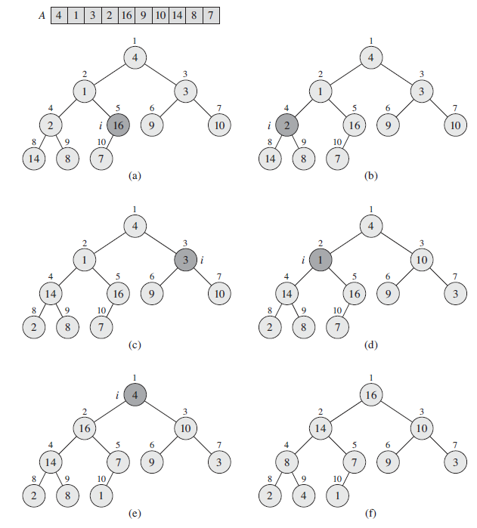
BuildHeap() Example
Emdad Khan

Slide 27
Analyzing BuildHeap()
Each call to Heapify() takes O(lg n) time
There are O(n) such calls (specifically, ⎣n/2⎦)
Thus the running time is O(n lg n)
  Is this a correct asymptotic upper bound?
  Is this an asymptotically tight bound?
A tighter bound is O(n)
  How can this be? Is there a flaw in the above reasoning?
Emdad Khan

Slide 28
Analyzing BuildHeap(): Tight
To Heapify() a subtree takes O(h) time where h is the height of the subtree
  h = O(lg m), m = # nodes in subtree
  The height of most subtrees is small
Fact: an n-element heap has at most ⎡n/2^{h+1}⎤ nodes of height h
CLR 7.3 uses this fact to prove that BuildHeap() takes O(n) time
Emdad Khan

Slide 29
Heapsort
Given BuildHeap(), an in-place sorting algorithm is easily constructed:
  Maximum element is at A[1]
  Discard by swapping with element at A[n]
    Decrement heap_size[A]
    A[n] now contains correct value
  Restore heap property at A[1] by calling Heapify()
  Repeat, always swapping A[1] for A[heap_size(A)]
Emdad Khan

Slide 30
Heapsort
Heapsort(A)
{
BuildHeap(A);
for (i = length(A) downto 2)
{
Swap(A[1], A[i]);
heap_size(A) -= 1;
Heapify(A, 1);
}
}
Emdad Khan

Slide 31
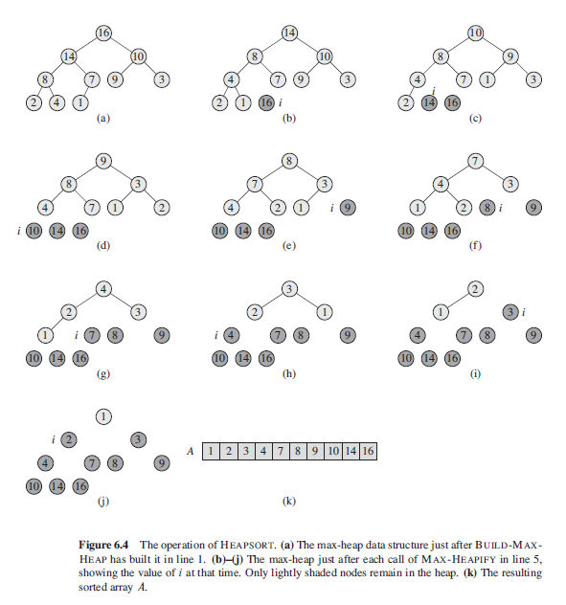
Heapsort - Example
Emdad Khan

Slide 32
Analyzing Heapsort
The call to BuildHeap() takes O(n) time
Each of the n - 1 calls to Heapify() takes O(lg n) time
Thus the total time taken by HeapSort()
= O(n) + (n - 1) O(lg n)
= O(n) + O(n lg n)
= O(n lg n)
Emdad Khan

Slide 33
Priority Queues
Heapsort is a nice algorithm, but in practice Quicksort usually wins
But the heap data structure is incredibly useful for implementing priority queues
  A data structure for maintaining a set S of elements, each with an associated value or key
  Supports the operations Insert(), Maximum(), and ExtractMax()
  What might a priority queue be useful for?
Emdad Khan

Slide 34
Priority Queue Operations
Insert(S, x) inserts the element x into set S
Maximum(S) returns the element of S with the maximum key
ExtractMax(S) removes and returns the element of S with the maximum key
How could we implement these operations using a heap?
  E.g. scheduling jobs on a shared computer
Emdad Khan

Slide 35
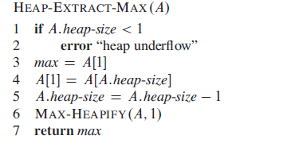
Priority Queue Operations – Implementation of Extract-Max
Emdad Khan

